Slide 1

6th Grade Accelerated Math
Unit 9, Lesson 1 Types of Data Volume 2, pg. 41

Slide 2


Benchmark
MA.6.DP.1.1
Recognize and formulate a statistical question that would generate numerical data.
volume 2, pg. 41

Slide 3
Integrated Mathematical Thinking and Reasoning Standards
MA.K12.MTR.1.1 Actively participate in effortful learning both individually and collectively.
MA.K12.MTR.7.1 Apply mathematics to real-world contexts.
volume 2, pg. 41

Slide 4

Learning Target
I can classify data as categorical or numerical.
volume 2, pg. 41

Slide 5

Warm-Up
volume 2, pg. 41

Slide 6
9.1.1 Warm-Up: Using Data
At the end of the school year, the school administration will ask students to participate in a survey about their favorite class.
What are two possible questions the survey could ask?
Makayla thinks it would be helpful to ask students to rank their current classes on a scale of 1-6, with 1 being the students’ favorite class and 6 representing their least favorite. Explain how this data could be useful.
volume 2, pg. 41

Slide 7

Guided Instruction
volume 2, pg. 42

Slide 8

9.1.2 Guided Instruction: Types of Data
A statistical question is a question that can be answered by collecting data. Often, there will be variability in the data.
Examples and non-examples of statistical questions are shown.
Statistical Questions | NOT Statistical Questions
How many siblings do the students in my class have? How tall are the players on the girls’ basketball team? What is the favorite song of the 6th graders at my school? | What time does school start? Who is the President of the United States? What is Avery’s favorite color?
volume 2, pg. 42

Slide 9
With your partner, discuss the differences between the two types of questions. What do you notice?
What do you think “variability in the data” means?
Data are values that are collected together for reference or analysis.
volume 2, pg. 42

Slide 10
Work together to develop a statistical question. Use your question to gather five data values from your classmates. The answers to your question should all be numeric. Your classmates’ responses are the data values.
Complete the table.
Question
Data
volume 2, pg. 42

Slide 11
Does the data from your question show a lot of variability or little variability?
Explain how you determined your description of the variability.
volume 2, pg. 42

Slide 12
Two statistical questions are shown. Question 1: “How many siblings do the students at my school have?” Question 2: “How many hours do the teachers at my school spend outdoors on a weekend?”
Explain which question you would expect to have more variability.
Discuss your choice with your partner.
volume 2, pg. 43

Slide 13
Data can fall into two different classifications — categorical or numerical.
Categorical data is a type of data that is divided into groups. Categorical data are qualitative.
Numerical data, or quantitative data, is a type of data that is measurable. It is collected in the form of numbers.
volume 2, pg. 43

Slide 14
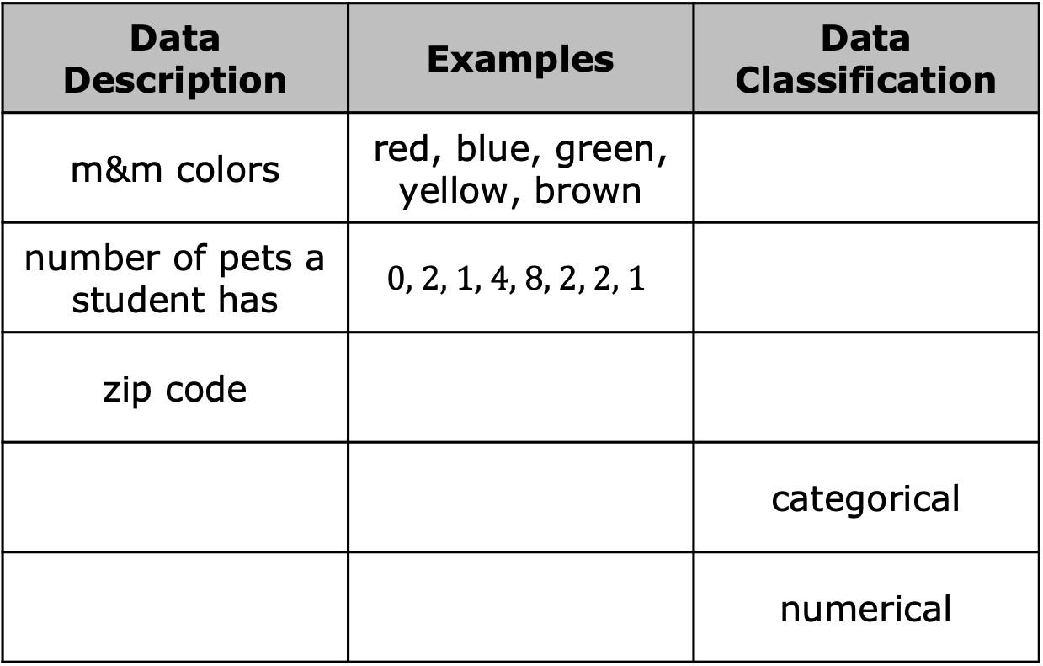
In the table, classify the type of data described, or provide an example of data with that classification.
Data Description | Examples | Data Classification
m&m colors | red, blue, green, yellow, brown
number of pets a student has | $$\text{0, 2, 1, 4, 8, 2, 2, 1}$$
zip code
 |  | categorical
 |  | numerical
volume 2, pg. 43

Slide 15

Exploration
volume 2, pg. 44

Slide 16

9.1.3 Exploration: Class Survey
Answer the following questions. Write your answers in the table under the number that corresponds to each question.
How many letters are in your first name?
How old are you, in years?
What is your favorite food?
What is your favorite sport?
How many languages do you speak fluently?
What languages do you speak fluently?
Your Responses to Each Question
a. | b. | c. | d. | e. | f.
volume 2, pg. 44

Slide 17
Review the display of the combined class data.
Which data sets are categorical?
Which data sets are numerical?
volume 2, pg. 44

Slide 18

Guided Practice
volume 2, pg. 44

Slide 19

9.1.4 Guided Practice: Classifying Data
A city parks department recently collected information about the breeds of dogs visiting a local dog park. They discovered that over 50 breeds of dogs visited the park on Saturday. Determine if the data is categorical or numerical. Explain your thinking.
volume 2, pg. 44

Slide 20
At the beginning of the season, the football coach creates a roster with the players’ names, ages, grade levels, and uniform numbers.
Which of the variables are categorical?
Which of the variables are quantitative?
For each variable, explain how you determined the type of data.
volume 2, pg. 44

Slide 21
What is the average weight of an elephant, in pounds?
What is your guess? _______________
Compare your answer with four other students. What do you notice?
Is this categorical or numerical data?
volume 2, pg. 45

Slide 22
Create a statistical question that will result in categorical data being collected.
Create a statistical question that will result in quantitative data being collected.
volume 2, pg. 45

Slide 23

Your Turn
volume 2, pg. 45

Slide 24
9.1.5 Your Turn!
Classify each variable as Categorical (C) or Numerical (N).
Social media followers _____
Color of cars in the faculty parking lot _____
Shoe size _____
Cost of a drink _____
Zip code _____
Type of pets you have _____
Will the question, “What is your favorite television or movie streaming service to use?” result in categorical or quantitative data? Explain how you made your choice.
volume 2, pg. 45

Slide 25
Given this bar chart, classify the data as categorical or quantitative.
volume 2, pg. 46

Slide 26

Wrap-Up
volume 2, pg. 46

Slide 27
9.1.6 Wrap-Up: Error Analysis
Bradley’s teacher asked him to circle the numerical data in the table below.
Name | Student ID | Age | Hair Color | Grade Level
Rachel | 1254866 | 10 | Brown | 6
Elijah | 2548631 | 11 | Brown | 6
Chase | 2645852 | 11 | Blonde | 6
Ben | 2548654 | 10 | Black | 6
His teacher said that his response was incorrect. Correct his mistake and explain what mistake he made.
volume 2, pg. 46

